Slide 1
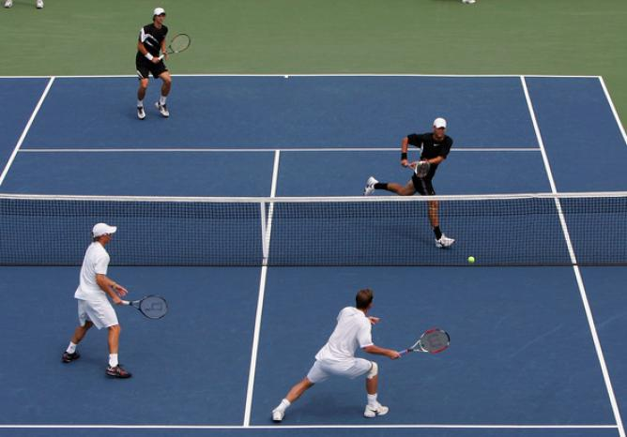
Matched two sample tests
Geog4300/6300
Jerry Shannon

Slide 2
Variablesc | Tests; test statistics; SE
Continuous; one sample: σ known and n > 30 OR data is a proportion | One-sample z-test; Z; SE = σ/sqrt(n); OR Diff. of proportions
Continuous; one sample: σ unknown or n < 30 | One-sample t-test; t; SE = s/sqrt(n-1)
Continuous; two samples | Student’s t-test for difference of means
Continuous; paired samples | Paired t-test
Continuous; more than two samples | ANOVA
Discrete; two variables; counts | Chi-square, goodness of fit
Continuous; two or more variables | Regression
You are here

Slide 3
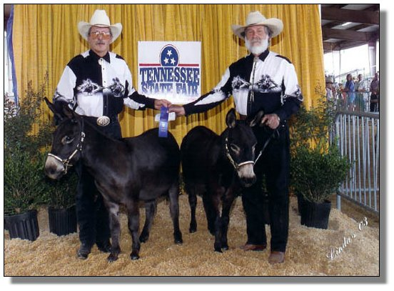
What if we have two samples that are
NOT independent?
Multiple climate readings for the same location
Survey responses in a longitudinal study
Before and after conditions for a change in policy
This is called a “matched pair” test.

Slide 4
Matched pair tests
Stream gauges
 | 1990 | 2010
A | 334 | 316
B | 231 | 217
C | 261 | 226
D | 215 | 176
E | 209 | 215
F | 336 | 327
G | 393 | 335
H | 141 | 155
I | 185 | 128
J | 242 | 244
K | 122 | 129
L | 195 | 175
M | 421 | 379
N | 226 | 196
Measures and averages differences between pairs
Items from sample 2 are matched with sample 1
Here: 14 stream gauge readings from the same locations in 1990 and 2010.
Does this show an decrease in stream flow?

Slide 5
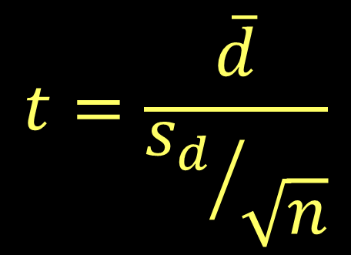
Matched pair tests
Test statistic compares mean difference to overall variance
Mean matched pair difference
 | 1990 | 2010 | diff
A | 334 | 316 | 18
B | 231 | 217 | 14
C | 261 | 226 | 35
D | 215 | 176 | 39
E | 209 | 215 | -6
F | 336 | 327 | 9
G | 393 | 335 | 58
H | 141 | 155 | -14
I | 185 | 128 | 57
J | 242 | 244 | -2
K | 122 | 129 | -7
L | 195 | 175 | 20
M | 421 | 379 | 42
N | 226 | 196 | 30
Standard error of the mean difference

Slide 6
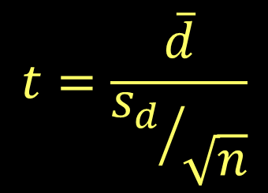
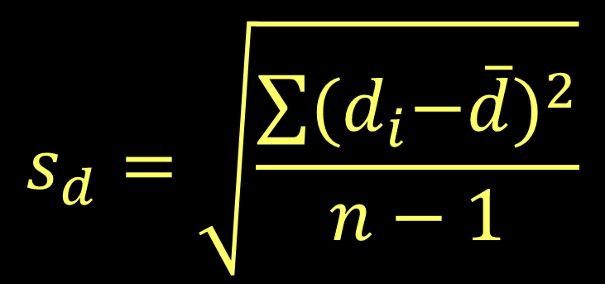
Matched pair tests
 | 1990 | 2010 | diff
A | 334 | 316 | 18
B | 231 | 217 | 14
C | 261 | 226 | 35
D | 215 | 176 | 39
E | 209 | 215 | -6
F | 336 | 327 | 9
G | 393 | 335 | 58
H | 141 | 155 | -14
I | 185 | 128 | 57
J | 242 | 244 | -2
K | 122 | 129 | -7
L | 195 | 175 | 20
M | 421 | 379 | 42
N | 226 | 196 | 30
Measures variance of the pair difference

Slide 7

Matched pair tests
 | 1990 | 2010 | diff
A | 334 | 316 | 18
B | 231 | 217 | 14
C | 261 | 226 | 35
D | 215 | 176 | 39
E | 209 | 215 | -6
F | 336 | 327 | 9
G | 393 | 335 | 58
H | 141 | 155 | -14
I | 185 | 128 | 57
J | 242 | 244 | -2
K | 122 | 129 | -7
L | 195 | 175 | 20
M | 421 | 379 | 42
N | 226 | 196 | 30
What’s our null and alternate hypothesis?
$$H_{0}: μ_{1980}≥μ_{2010}$$
$$H_{0}: μ_{1980}<μ_{2010}$$
This is a one tailed test.

Slide 8

Matched pair tests
 | 1990 | 2010 | diff
A | 334 | 316 | 18
B | 231 | 217 | 14
C | 261 | 226 | 35
D | 215 | 176 | 39
E | 209 | 215 | -6
F | 336 | 327 | 9
G | 393 | 335 | 58
H | 141 | 155 | -14
I | 185 | 128 | 57
J | 242 | 244 | -2
K | 122 | 129 | -7
L | 195 | 175 | 20
M | 421 | 379 | 42
N | 226 | 196 | 30
d.f. = n-1 = 13
For a one tailed test with 13 df,
the critical value is 1.77
You can use the critical value listed for a 90% two tailed test

Slide 9
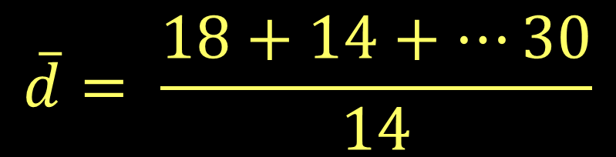
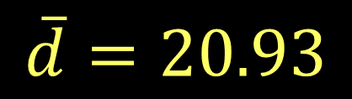
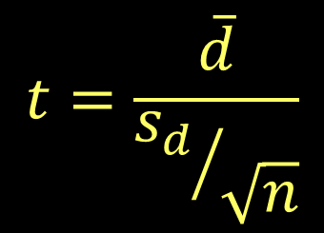
Matched pair tests
 | 1990 | 2010 | diff
A | 334 | 316 | 18
B | 231 | 217 | 14
C | 261 | 226 | 35
D | 215 | 176 | 39
E | 209 | 215 | -6
F | 336 | 327 | 9
G | 393 | 335 | 58
H | 141 | 155 | -14
I | 185 | 128 | 57
J | 242 | 244 | -2
K | 122 | 129 | -7
L | 195 | 175 | 20
M | 421 | 379 | 42
N | 226 | 196 | 30

Slide 10
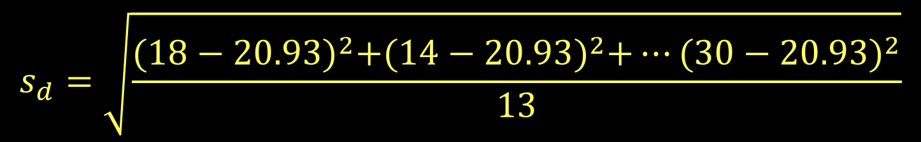


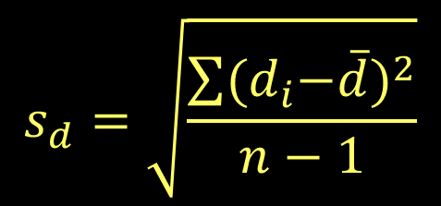
Matched pair tests
 | 1990 | 2010 | diff
A | 334 | 316 | 18
B | 231 | 217 | 14
C | 261 | 226 | 35
D | 215 | 176 | 39
E | 209 | 215 | -6
F | 336 | 327 | 9
G | 393 | 335 | 58
H | 141 | 155 | -14
I | 185 | 128 | 57
J | 242 | 244 | -2
K | 122 | 129 | -7
L | 195 | 175 | 20
M | 421 | 379 | 42
N | 226 | 196 | 30

Slide 11
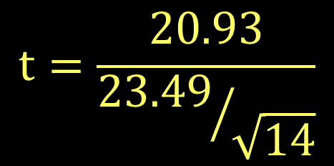
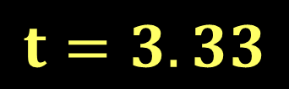
Matched pair tests
 | 1990 | 2010 | diff
A | 334 | 316 | 18
B | 231 | 217 | 14
C | 261 | 226 | 35
D | 215 | 176 | 39
E | 209 | 215 | -6
F | 336 | 327 | 9
G | 393 | 335 | 58
H | 141 | 155 | -14
I | 185 | 128 | 57
J | 242 | 244 | -2
K | 122 | 129 | -7
L | 195 | 175 | 20
M | 421 | 379 | 42
N | 226 | 196 | 30

Slide 12
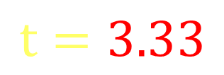
Matched pair tests
 | 1990 | 2010 | diff
A | 334 | 316 | 18
B | 231 | 217 | 14
C | 261 | 226 | 35
D | 215 | 176 | 39
E | 209 | 215 | -6
F | 336 | 327 | 9
G | 393 | 335 | 58
H | 141 | 155 | -14
I | 185 | 128 | 57
J | 242 | 244 | -2
K | 122 | 129 | -7
L | 195 | 175 | 20
M | 421 | 379 | 42
N | 226 | 196 | 30
What’s the result of our analysis?
This t value exceeds our critical value.
We can reject the null hypothesis.

Slide 13
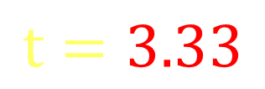
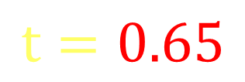
Matched pair tests vs. independent sample
 | 1990 | 2010 | diff
A | 334 | 316 | 18
B | 231 | 217 | 14
C | 261 | 226 | 35
D | 215 | 176 | 39
E | 209 | 215 | -6
F | 336 | 327 | 9
G | 393 | 335 | 58
H | 141 | 155 | -14
I | 185 | 128 | 57
J | 242 | 244 | -2
K | 122 | 129 | -7
L | 195 | 175 | 20
M | 421 | 379 | 42
N | 226 | 196 | 30
Matched pairs have smaller standard errors
This ignores the dispersion in the sample
This allows more frequent rejection of the null hypothesis.

